Slide 1
Supporting the PaN EOSC services
11th November, 2020
Author: J-F. Perrin on behalf of the WP6 team.

Slide 2
PaNOSC WP6 aims
Support the PaNOSC services (WP3/4/5/8) to integrate EOSC.
Users’ productivity: remove technical hurdles, simplify users access to data and services.
Prepare RIs’ IT infrastructure for EOSC.
Today’s agenda
Data transfer: bringing data to services or vice versa, quest for the right model (depending on the service type, data volume, …)
Authentication and Authorisation Infrastructure (AAI): common user authentication for all PaNOSC (EOSC?) services
Other ongoing activities

Slide 3
PaN RI typical environment
Large user community (50 000 users/18 Months) with heterogenous profiles:
Scientific field: Biology, Material science, chemistry … Archaeology, nuclear physic, HEP
Academic and Industrial users
Quite often very limited IT support in the users’ home organisation
Datasets volume vary from 10s of GB to 100s of TB
Yearly data production from 300TB to 10s of PB
Data are openly accessible after a 3 years embargo period
Relatively small IT teams, mainly focused on data production (i.e. experiments) support and integration of existing solutions

Slide 4
Technical RI environment regarding data storage at RIs.
Central archive on RI network: Large disk storage (typically GPFS) + Tape (cold storage)
ACLs (Typically NFSv4) at the filesystem level
Local user ID that needs to be mapped to federated AAI ID
Users access to data store through gateways (NFS, SMB, Rsync, FTP, ...)

Slide 5
PaNOSC data transfer activities
Support from UKRI-STFC and CESNET (EGI.eu Linked Third Parties)
Participation in EGI data transfer WG https://wiki.egi.eu/wiki/TCB:Data_Transfer_WG

Slide 6
PaNOSC data transfer use cases
Three clearly identified use cases:
An RI wants to archive its experimental data in a remote data centre. Cold backup
A user wants to access a data analysis service, data has to be available “transparently”
A facility user wants to transfer a large dataset from an RI’s archive to a remote compute center or her/his home PC

Slide 7
1st Use case : Archiving
Aims
Automate cold backup of raw data after experiment
Restore data
Pilot
ILL as RI (data producer) (GPFS + NFS gateway)
UKRI-STFC as archive centre (Ceph S3 interface)
Solutions evaluated
FTS / GridFTP
Rucio
Rclone (https://rclone.org/)

Slide 8
2nd Use case: EGI Data-Hub
Objectives
Transfer data to “EOSC” (i.e. not necessarily from the PaN community) data treatment services
Transfer data transparently from the point of view of the users
Archive the results back to the originating RI
Authenticate users using EOSC ready AAI (UmbrellaID)
Authorise data access (open or embargo data)

Slide 9


2nd Use case: EGI Data-Hub
Data treatment service
Community ?
HPC? Kubernetes? OpenStack?
Cache
Local network
GÉANT network (100’s km)
Archive
Archive
Archive
Archive

Slide 10


Initial results
Data treatment service
Promising pilot:
Provide the same interfaces for data independently of the archive location
Transfer is transparent from the users’ point of view
Performance with small datasets seems acceptable
Still need to understand the limits (dataset size, … ) of the model
Integration difficulties when trying to deploy the pilot on production environment: hidden files (.snapshot) are creating pb, ACLs, Mapping of users ID (local to UmbrellaID)…
EOSC AAI model not yet ready for such a cross community use case
Acceptance tests to be done
HPC? Kubernetes? OpenStack?
Cache
PaNOSC
Archive

Slide 11
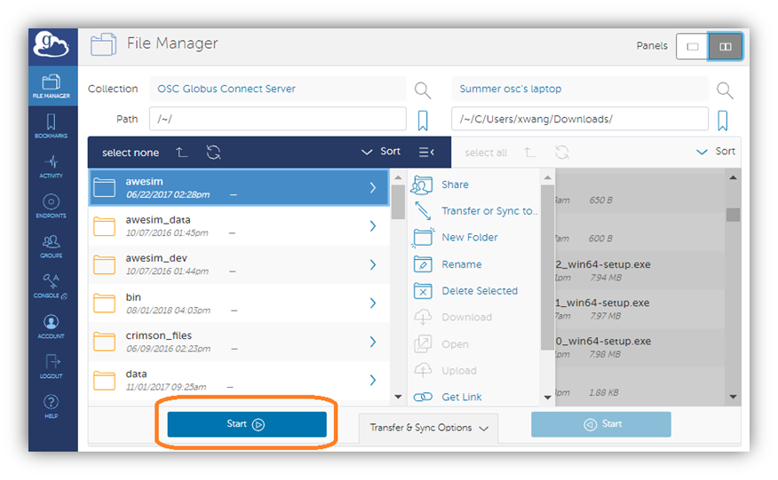
3rd use case: transfer of data by RI users
Aims
Provide a (super easy, reliable, able to resume transfer, without tricky configuration on the client side …) solution for RI users to transfer large datasets (10s of GB to 10s of TB) to their home lab/company
Potential user base: 10 000 users
Pilot
ESRF as RI (data producer) (GPFS + NFS gateway)
ESRF users as receivers
Solution envisaged
Globus
IBM Aspera

Slide 12
AAI - UmbrellaID
Strong collaboration with GÉANT and PSI
Participation in AEGIS (AARC engagement group)
https://wiki.geant.org/display/AARC/AEGIS

Slide 13
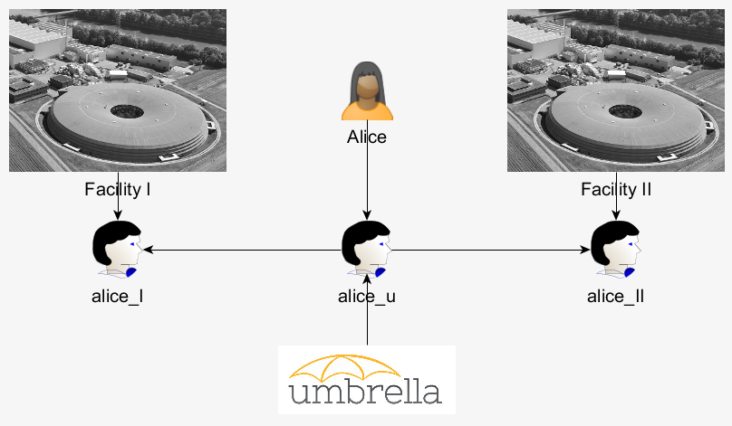

AAI
UmbrellaID is the AAI of the PaN community (PaNOSC + ExPaNDS + … ) since 2012
Provide a common Authentication and Authorisation Infrastructure that allows users of all PaN facilities to connect seamlessly to digital facility services with a single and unique ID (i.e. Common ID)
Authorisations remain fully under control of each facility providing the services
Users are in full control of their personal data
https://umbrellaid.org/what.html

Slide 14
AAI
PaNOSC objectives:
Integrate EOSC – i.e. move to the AARC BluePrint Architecture (BPA)
Reach global and comprehensive interoperability with services outside of the Photon and Neutron domain
Take into account growing security constraints and legal requirements
Increase capacity to respond to user needs in a stable, secure and trusted environment (training and support)
Collaborate closely with GÉANT to achieve the above objectives

Slide 15
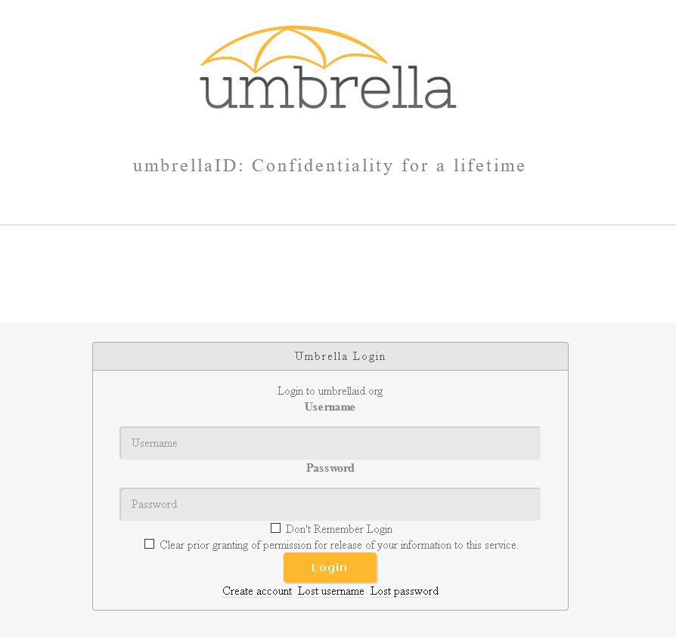
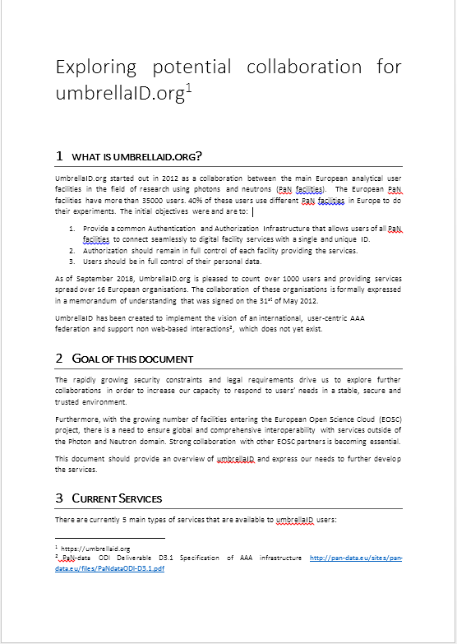
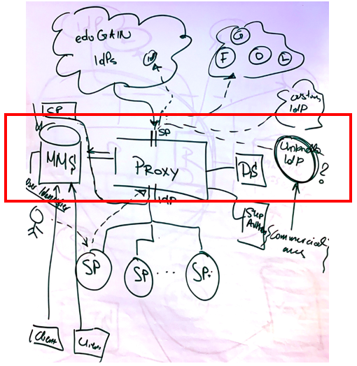
AAI
Looking for collaboration
Specifications
Initial contact with GÉANT
July 2019
Validation by the UmbrellaID mgmt. team.
Autumn 2019
Set up of the dedicated eduTEAMS platform
Validation
Spring 2020
Production ready
New services introduced
Summer 2020
Migration of all SP to the new infrastructure
Additional metadata
Autumn 2020
New IdPs: Orcid, eduGain
Migration of all users
Decommisioning UmbrellaID IdPs
Spring 2021

Slide 16
PaN software catalogue

Slide 17
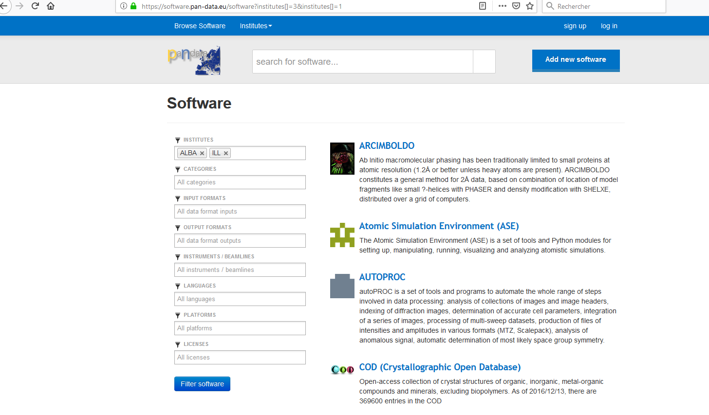
PaN software catalogue

Slide 18
2020 Survey community outcomes
https://software.pan-data.eu
Is de facto the reference software catalogue for the PaN community, but not used yet by all facilities
It references analysis and simulation software supported by the PaN facilities
Provides complete examples with data sets
Practical example from scientific instruments/beamlines
Further requirements:
Provide reference to Docker/VM image registries
Creation of a container registry
Currently investigate by ILL (is it really necessary? Benefits? Tech solutions?)
Creation of APIs to access the content of the catalogue
Possibility to further link with other catalogues (EOSC, facilities data catalogues/portals)
Integrate EOSC monitoring/accounting tools when ready

Slide 19
Current status
D6.1 Report has been delivered in due time MS19 slightly delayed (2/3 weeks)
Challenges:
COVID crisis since Jan/Feb 2020
System/network admin job market is very tight (extremely difficult to hire)

Slide 20
Work ahead 1/2
Integrate new colleagues (François, Gregory, Teodor, William … and more to come)
AAI: Take benefits of the UmbrellaID platform
Move the existing services to the new infrastructure (SPs)
Organise trainings for RI staff (SAML/Oauth, Keycloack) and documentation to lower the technical hurdles
Integrate EduGain and take benefits of the new metadata possibilities
Connect the new PaN services to UmbrellaID
Data Transfer
Go to production (when the solution fits) and provide feedback to the community
Remain open: explore new ideas (e.g. data lake), new technical solutions
Identify the limits of the different data transfer and processing scenarios

Slide 21
Work ahead 2/2
Software catalogue
Implement the requested features (mid 2021)
Encourage uptake
EOSC service integration
2 services to publish, more expected (which one? when?)
Expecting guidelines from EOSC portal centric projects (EOSC-Enhance, ...)
Benefits from the project and its participants for working on current or future challenges
Software provisioning (CERNVMFS, …) tbd
EOSC-Future
Cloud procurement
Gather needs from partners
Tender vs collaboration with existing initiative (e.g. OCRE)

Slide 22
Thank you Join with your solution or challenges of common interest
wp6@panosc.eu

